Slide 1
Early Work On Image Pattern Analysis
Erik Cruz Martinez

Slide 2
Goals and Topics
Analyze and take notes over PTKFO_VAE.ipynb file
Explore methods and strategies for identifying image patterns
Meet with Richard for instrument operation lessons
Begin Creating a demo project

Slide 3
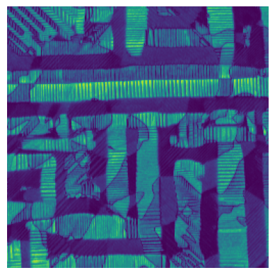
Gathering Initial Data
TARGET 1
Function get_image_stack lists all the files in the path and is read from a DM3 reader
It grabs one channel from image_data[channel]
TARGET 2
Function extract_subimages moves images in steps
collects image cutouts
Returns subimages, centers arrau
TARGET 3
While the material is unknown we can still find information using several techniques

Slide 4
Variational Autoencoder

Slide 5
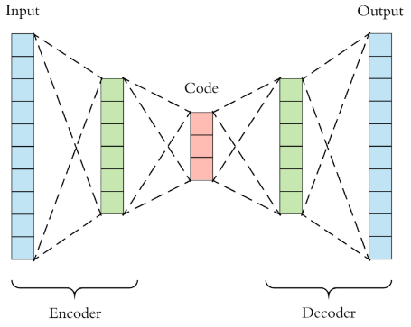
Understanding Variational Autoencoder
A Variational Autoencoder (VAE) is a type of neural network that learns to compress and reconstruct data (usually images)
It also learns a smooth meaningful “map” of the data in a low-dimensional space called the latent space
It has two main parts: encoder and decoder

Slide 6
Encoder
The encoder compresses a high dimension image into a smaller dimension known as the bottleneck
The output has two vectors - mean and standard deviation - that describe a probability distribution for where this images lives in the latent space
In other words: instead of just squashing the image into one vector, the encoder learns “this image is probably around here in this 2D space”

Slide 7
Decoder
The input is a random sample from the mean and standard deviation distribution
The output is a reconstructed image that should look like the original input
The decoder learns to turn points in latent space to realistic images

Slide 8
Training Idea
To put it simply,for each patch in the training loop is:
ENCODE
DECODE
ANALYZE
UPDATE
Encoder predicts the mean and standard deviation which then samples z from that distribution
Decoder recontructs the patch from Z, which is then compared to the original (reconstruction lost)
Keep z close to a normal Gaussian (KL loss)
Update the network to do better
Strategic
budgeting
Strategic
budgeting
Strategic
budgeting
Strategic
budgeting
Decrease avg time-to-hire by 20%. Achieve 50% participation in leadership program.
Decrease avg time-to-hire by 20%. Achieve 50% participation in leadership program.
Decrease avg time-to-hire by 20%. Achieve 50% participation in leadership program.
Decrease avg time-to-hire by 20%. Achieve 50% participation in leadership program.
XX
1
XX
2
XX
3
XX
4

Slide 9
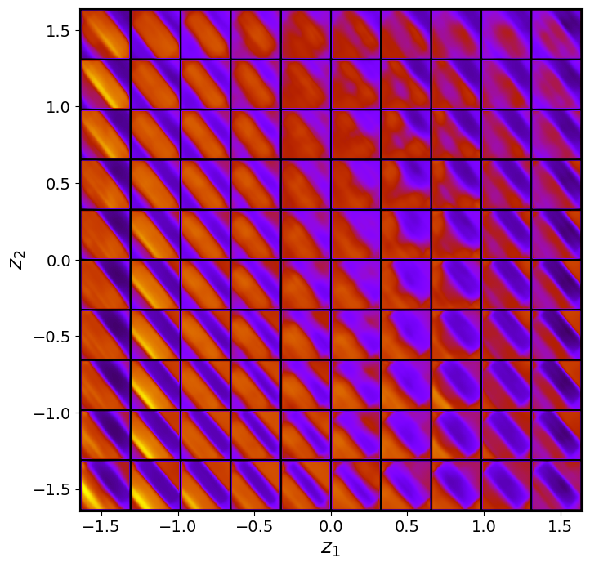
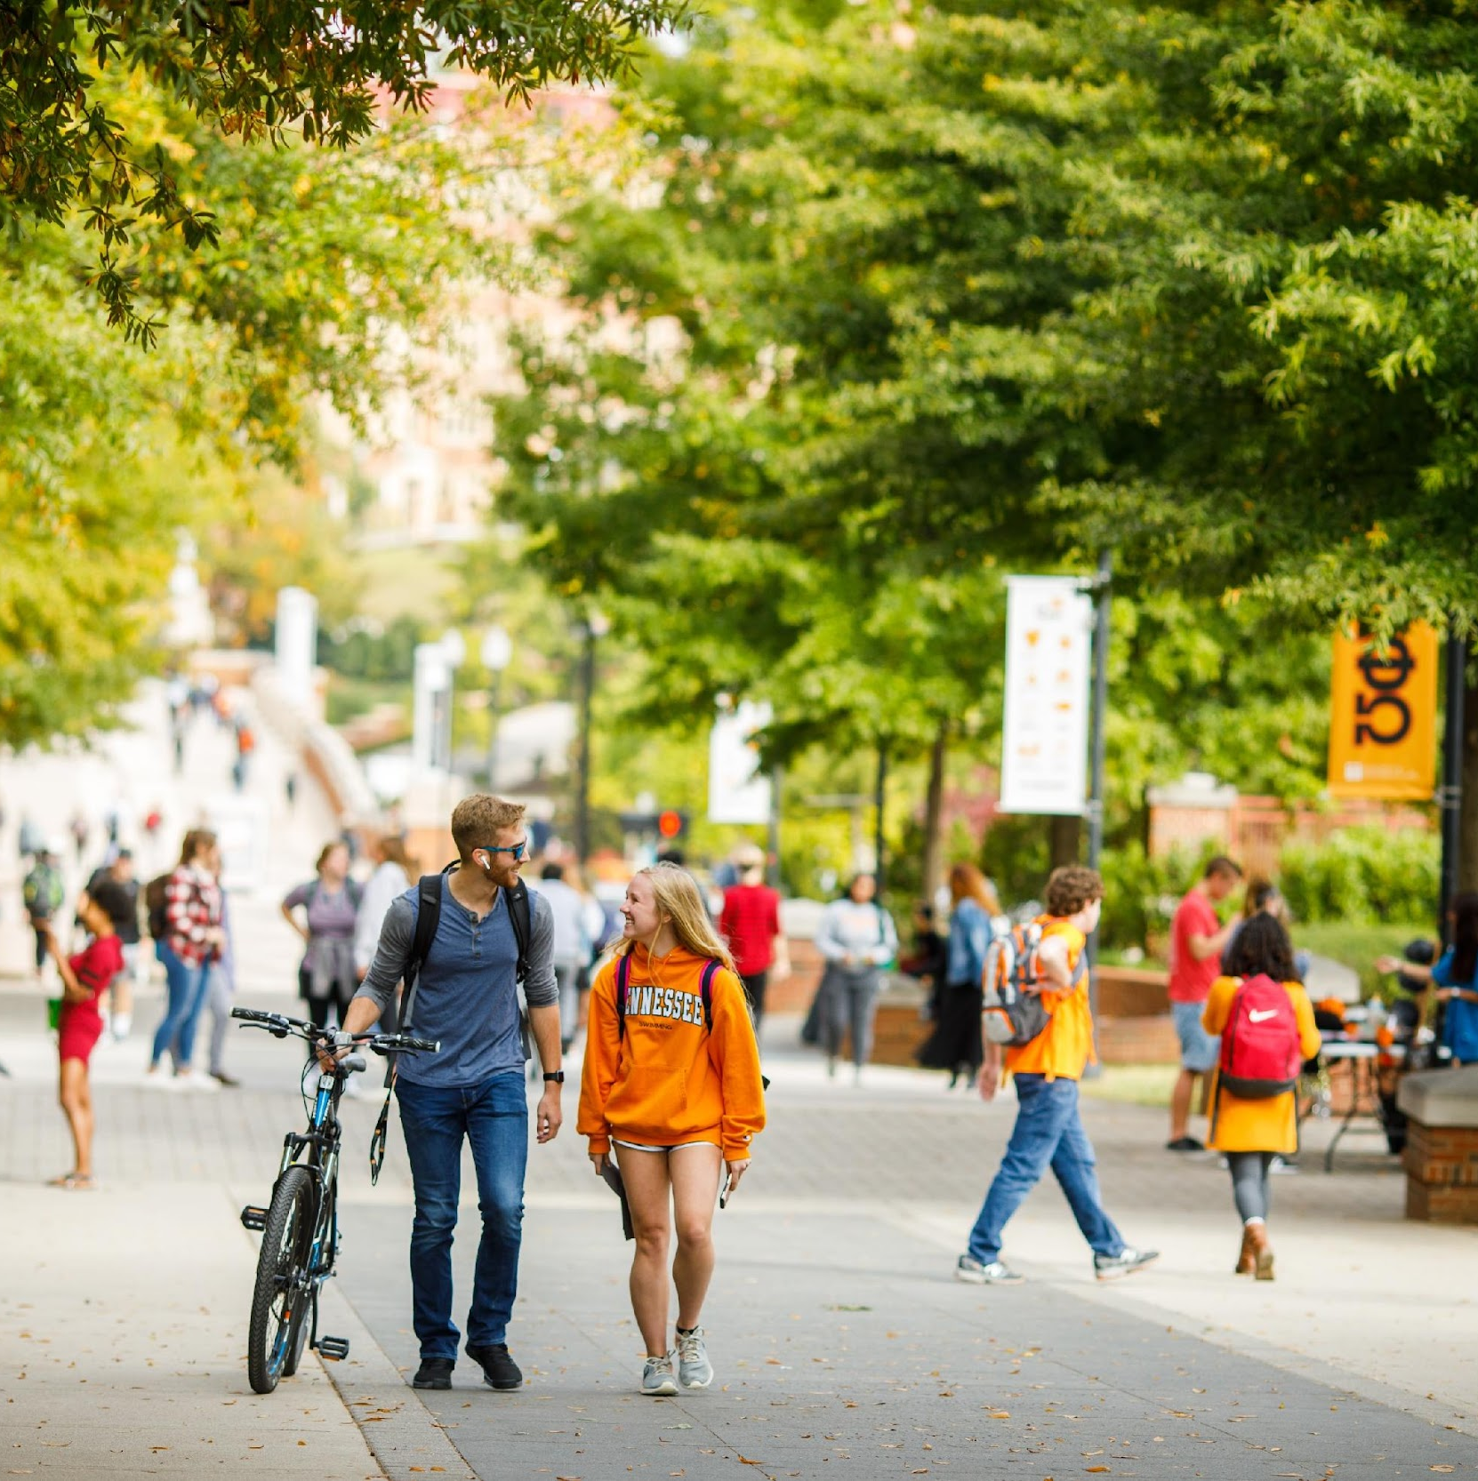
Relating Back to PTKFO
In the python journal, they train VAE on patches
Why?
The interesting features are local patterns, not the whole image at once
Creates enough training data to learn a meaningful latent space
What is this picture? - A latent space grid that shows the two latent dimensions
How does this help?
Dimensionality Reduction
Feature Discovery - We can cluster them, color them, or map them back to physical coordinates

Slide 10
Latent Space with Kernel Density Estimation

Slide 11
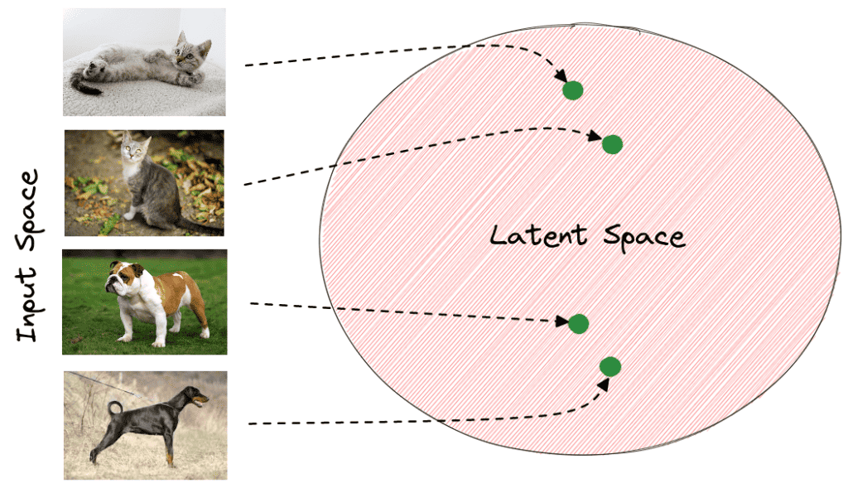
Understanding Latent Space
Latent Space is a compressed, lower-dimensional data that captures its essential features and hidden relationships
Each point represents features extracted from data (like image patches)
Similar patterns are placed close together in the latent space

Slide 12
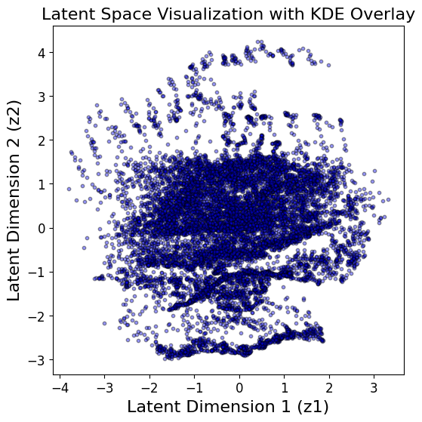

Latent Space with KDE
Kernel Density Estimation (KDE): highlights areas where many points are concentrated
It combines reduced-dimension plot (Z1,Z2,axes) with a KDE to highlight areas of concentration
Helps identify groups of similar textures or features

Slide 13
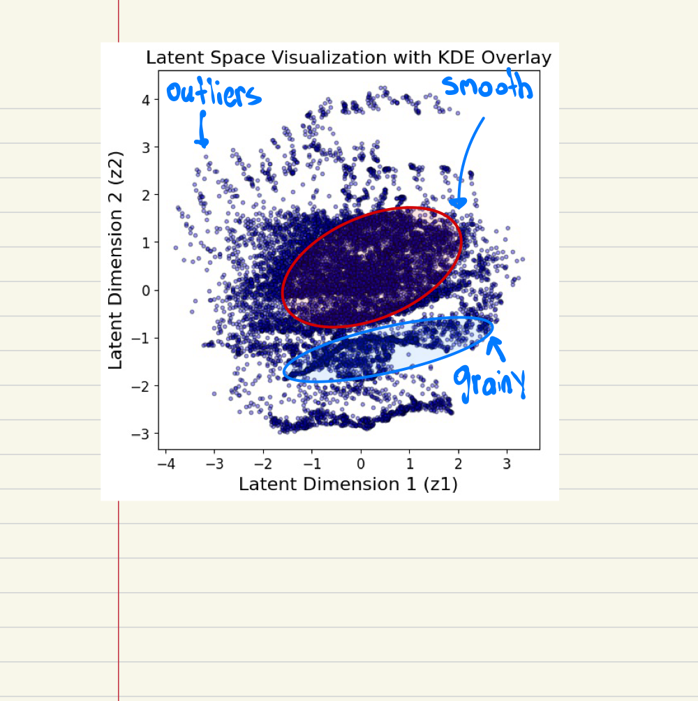
Relevance to Project
Understanding latent clusters helps:
detect and group similar textures
Identify underlying structure in data
Example:
Dots representing small image patches
“smooth” texture patches = form one cluster
“Grainy” texture patches = form another cluster

Slide 14
What Comes Next?

Slide 15
Upcoming Goals and Tasks
Continue instrument lessons
Research articles Richard provided
Machine Learning-Based Reward-Driven Tuning of Scanning Probe Microscopy: Toward Fully Automated Microscopy
A Practical Guide to Scanning Probe Microscopy SPM
Take notes and understand the code from the software used to create aespm -- "A"utomated "E"xperiment on "SPM"
Create demo project

